Slide 1








Team Name:
Team Lead Name:
Track:
Problem Statement title:
Q-Hack India 2026

Slide 2

The "Black Box“ Problem of Classical Randomness
We are solving the fundamental lack of verifiable trust in high-stakes random draws, such as lotteries, blockchain validator selection, IPO allotments, and crypto token drops.
The Context:
Currently, digital systems rely on Classical PRNGs (Pseudorandom Number Generators) which use hidden mathematical algorithms and secret "seeds" to pick numbers. Because this operates as a "black box," a genuinely fair draw and a maliciously rigged draw look completely identical from the outside. Users are forced to blindly trust the software vendor or the insider running the code, leaving massive financial systems highly vulnerable to undetectable manipulation.
Q-Hack India 2026

Slide 3

The High Cost of Unverifiable Trust
Who faces this problem?
This problem affects anyone managing or participating in high-stakes distributions: lottery commissions, cryptocurrency exchanges, financial regulators managing IPOs, and decentralized blockchain networks.
Why is it important?
When billions of dollars are at stake, trust is not enough. Because classical computing is "deterministic" (meaning the output is 100% predictable if you know the starting formula), systems are exposed to the "Insider Threat." For example, lottery security director Eddie Tipton secretly injected code into a PRNG to predict winning numbers, stealing millions. In the crypto space, weak randomness has led to heavily exploited wallets. If a vendor or insider can rig a draw and make it look perfectly normal, the entire foundation of digital fairness is compromised.
Q-Hack India 2026

Slide 4

Proposed Solution : ProvaFair - Randomness You Can Verify
We built ProvaFair: A Device-Independent Quantum Random Number Generator (DIQRNG) backed by a tamper-proof public audit ledger.
How it addresses the problem:
Instead of asking users to blindly trust a secret classical formula, ProvaFair transforms randomness into a live, verifiable physics experiment. Before any numbers are drawn, the system runs a CHSH Bell Test. By measuring highly connected "entangled" quantum particles, it calculates a physics score. If the score proves the particles are genuinely unpredictable, it extracts that true quantum entropy to pick the winners and logs a cryptographic receipt to a public database. If the system detects a rigged, classical pattern, the draw is automatically rejected.
Q-Hack India 2026

Slide 5
Why Quantum?
The Mathematical Proof of True Randomness
Why does quantum computing make sense here?
Classical computers are fundamentally incapable of true randomness; they require pre-programmed instructions. Quantum mechanics, however, contains inherent, physical unpredictability at the subatomic level, acting as the perfect enabler for our solution.
How it acts as a meaningful enabler:
We utilize the CHSH Bell Test to measure a pair of linked quantum particles (Quantum Entanglement). According to the laws of physics, a classical, pre-programmed system (using "Local Hidden Variables") can never achieve a CHSH score higher than 2.0. However, true quantum entanglement violates this limit, reaching up to roughly 2.82 (Tsirelson's bound). By demanding a score strictly greater than 2.0 before releasing any numbers, quantum technology provides absolute, mathematical proof that the draw is completely spontaneous and not rigged by a hidden seed.
Q-Hack India 2026

Slide 6
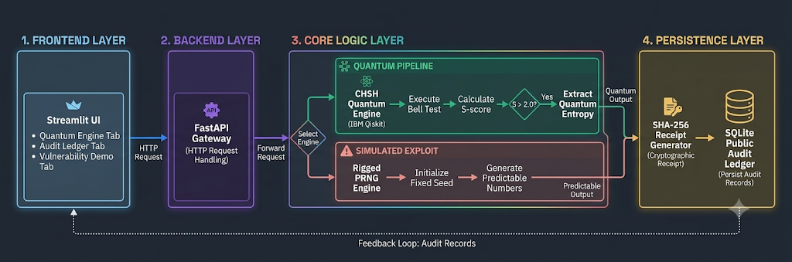
Implementation and Architecture
Technology Stack:
• UI & Backend: Streamlit (Python) & FastAPI
• Quantum Engine: IBM Qiskit & AerSimulator
• Security & Database: Python hashlib (SHA-256) & SQLite
Classical Components:
• API Gateway: Orchestrates the HTTP requests between the user interface and the quantum/rigged engines.
• PRNG Simulator: A deterministic "rigged" engine used to demonstrate the classical vulnerability (S ≤ 2.0).
• Immutable Ledger: Applies SHA-256 cryptographic hashing to the draw results, committing a permanent, verifiable receipt to the SQLite database.
Quantum Components:
• Entanglement Generation: Uses Hadamard (H) and Controlled-NOT (CX) gates to create linked Bell states.
• CHSH Evaluator: Measures qubits across multiple angles to verify the S-score > 2.0 limit.
• Entropy Extractor: Converts the raw, unpredictable quantum measurement memory into an unbiased random seed.
Core Quantum Math (CHSH Verification):
• Entangled State: |Φ⁺⟩ = (|00⟩ + |11⟩) / √2
• CHSH Formula: S = |E(A₀,B₀) - E(A₀,B₁) + E(A₁,B₀) + E(A₁,B₁)|
• Threshold: Classical systems cannot exceed S = 2.0. Our system verifies S > 2.0 (approaching Tsirelson's bound of 2.82) to guarantee true quantum entropy.
Q-Hack India 2026

Slide 7
Minimal Prototype
What have you actually built?
Show the minimal prototype, MVP, notebook, simulation, quantum circuit, hybrid application, visualization,
hardware experiment, or other working implementation.
Q-Hack India 2026

Slide 8
Results / Validation
What are the expected results or expected outcome?
What have you already validated or obtained?
Include the findings, results, observations, experiments, simulations, research, or other validation carried out through
the prototype or development work.
Q-Hack India 2026

Slide 9
Roadmap
If selected for Round 2, outline how you would take your project from prototype to a more complete solution?.
Explain the next steps, improvements, scaling plans, additional validation, and future development.
Q-Hack India 2026

Slide 10
References and Sources
Mention the research papers, repositories, documentation, datasets, or other sources referred to while developing the solution.
Relevant links should be accessible to the reviewers.
Clearly acknowledge any source of inspiration.
The final implementation should be the team’s own work and should not be a direct copy or fork of another repository.
Q-Hack India 2026

